Slide 1
Summer Enrichment Program at the University of Michigan School of Pubic Health
BY
[Insert Your Name}

Slide 2
Program Components
Paid 8-week internship at a hospital, community center or other healthcare organization in Southeast Michigan
Housing, transportation, food allowance, and GRE preparation provided at no cost
Weekly visits to area health organizations
Notes:
If there are more questions about the program components, please tell the student to visit the SEP website and/or contact SEP staff. The contact information is on the last slide.

Slide 3
UM SEP Video
Notes:
Click on the play button on the video. It is located on the bottom left of the video. The video is also on the UM SEP website homepage (http://www.sph.umich.edu/sep/index.html).

Slide 4
Application Components
Application Form
Two Essays
Transcript
Resume
Two Letters of Recommendation
Professional and/or Academic
Invited Interviews – early March
Acceptance Notifications – late March
Deadline: January 20, 2017 @ 11:59pm EST

Slide 5
2017 Program Timeline
Complete application submitted by January 20, 2017 @ 11:59pm EST
Virtual Interviews – early March
Acceptance Notifications – late March
On-site Orientation – May 31st, 2017
First day of internship – June 5th, 2017

Slide 6
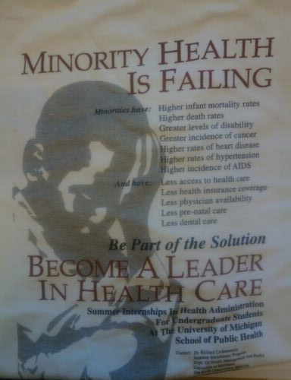
UM SEP Facts
This program is entering its 32nd year with 600+ alumni to date
Dr. Ebbin Dotson (UMSEP ‘98) serves as the Faculty Director
UMSEP attracts undergraduate students who want to improve the health status of underserved communities
Notes:
Sponsored by the University of Michigan School of Public Health, Health Management and Policy Department
Over 550 students participate in the Summer Enrichment Program since 1986. HMP and SEP alumni hold key leadership positions in local, state and federal government agencies, in health insurance plans, in special programs for the poor and disadvantaged, in health policy research and advocacy organizations, and in hospitals, clinics, HMOs, and health centers in the U.S. and abroad.

Slide 7
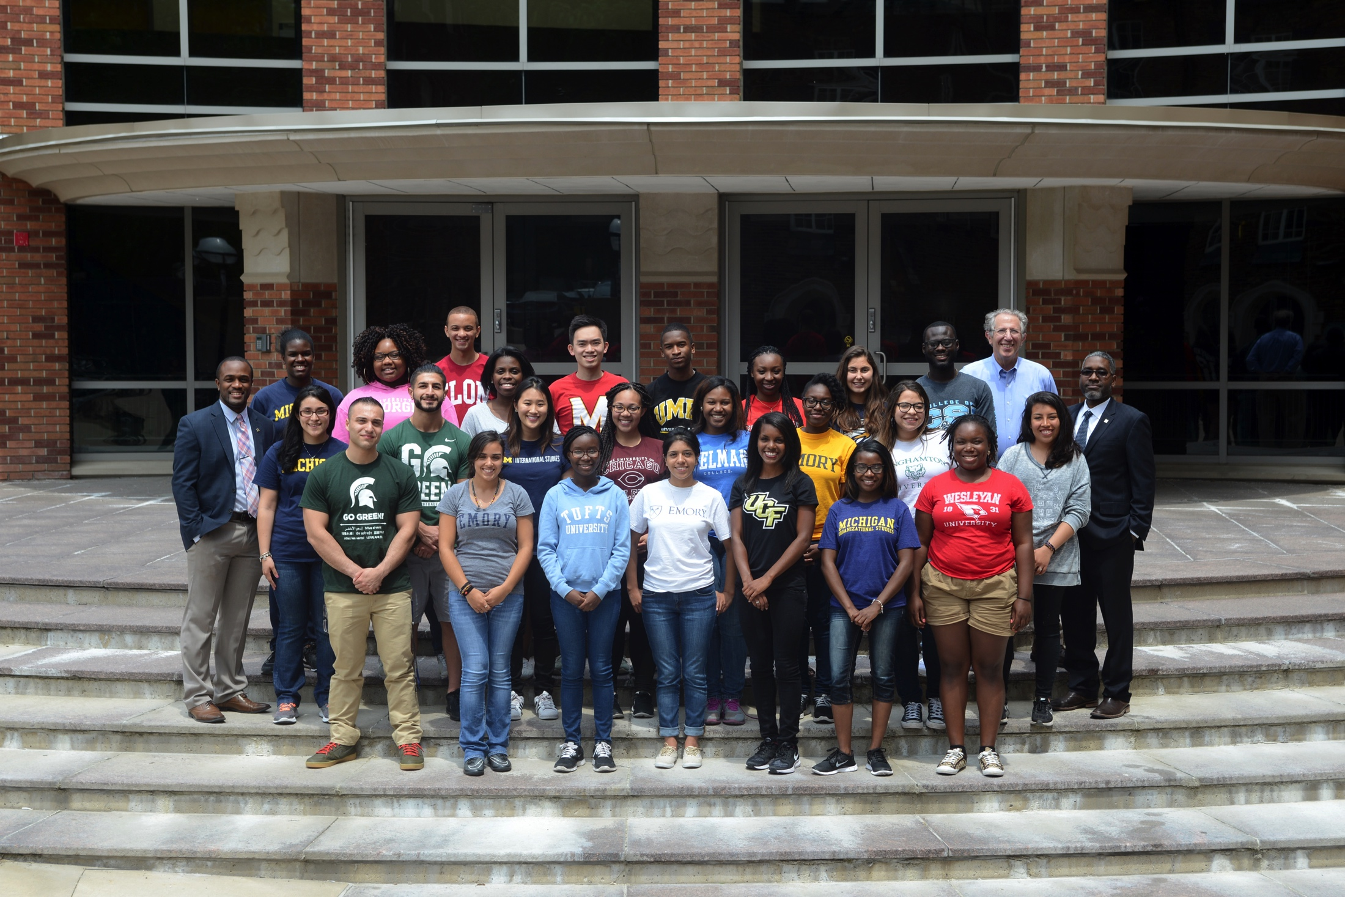
Personal experience and comments about UM SEP
Notes:
Talk about the program from your personal experience (e.g. how you found out about UM SEP, why you decided to apply, and what influenced your decision to participate in the summer program). Tell your audience how UM SEP impacted you, and gave you the tools to help others. Please add any helpful and relevant information. If you have any more questions about this part of the presentation, please contact the UM SEP staff.

Slide 8
Contact Information
Leadership:
Dr. Ebbin Dotson – Faculty Director
Mr. Christopher Clarke – Program Director
For more information, please contact UM SEP:
Email: um.sep@umich.edu
Phone: 734-936-3296
Website: http://www.sph.umich.edu/sep/
Notes:
If there are any questions you don’t know the answer to, please provide the program’s contact information. The SEP staff will get back to them asap. The application is available online through the UM SEP website. The students needs to click on the apply now tab, the student will be prompted to sign up for an account and fill out an application.

