Slide 1
The University of Michigan Summer Enrichment Program
Health Management And Policy

Slide 2
Agenda
UM SEP video
History of UM SEP
Outline program goals
Discuss program elements
Student quotes
Identify what alumni do after UM SEP
Questions and Answers

Slide 3
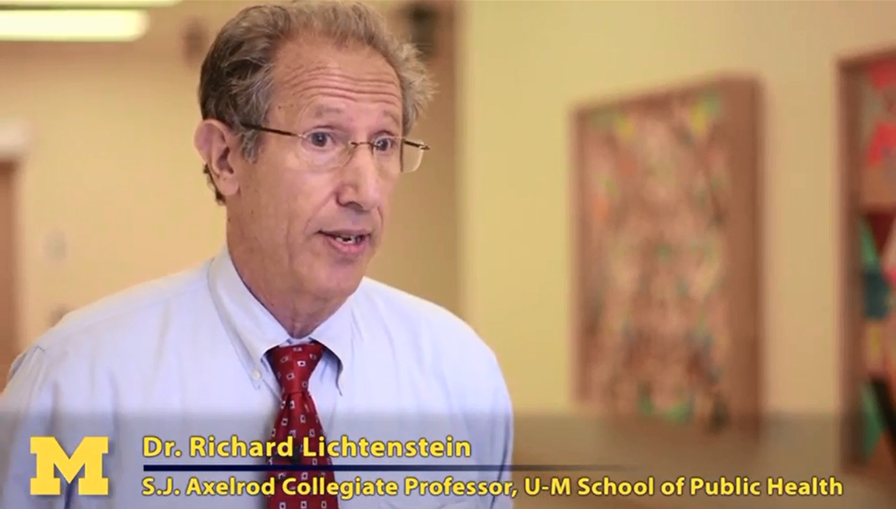
UM SEP VIDEO

Slide 4
UM SEP Goals
To identify health care management and policy professions that address health disparities.
To provide students with an internship that exposes them to populations that experience health inequalities and to health executives who work in organizations that serve undeserved populations.
To provide opportunities to learn more about health inequalities, health care organizations, health management and policy, the health care system and public health

Slide 5
UM SEP Program Elements
The 8-week program for undergraduate students includes:
Orientation to US Health System and health inequalities
Internship in health organization
Weekly field visits to health organizations; opportunities to meet senior-level executives
GRE preparation course
Advice about applying to graduate school
Room, board, travel and a $3,000 stipend

Slide 6
Student Quotes

Slide 7
What would you tell other undergraduate students about UM SEP?
“UM SEP is really a transformational experience that develops all of your talents and skills to their full potential with the support of wonderful staff and exceptional peers.” – Patty Avila
“UM SEP is a program not only to learn about health disparities, it's a program to learn about others, and a program to learn about yourself. During your summer in UM SEP, you can discover the role you want to have in combating health issues that you are passionate about.” – Quian Callendar

Slide 8
Describe What you Learned about yourself and your capabilities.
“I learned to appreciate every experience and treat each as a opportunity to learn and grow. By being involved in so many projects at my placement site, I realized my potential to be a knowledgeable resource for the community.”– Arrice Bryant
“This summer I learned the value of exposure... This exposure has provided me with a new outlook for my future and the confidence to know that I can accomplish much more than I ever imagined.”– Ray Lynem

Slide 9
UM SEP Alumni

Slide 10
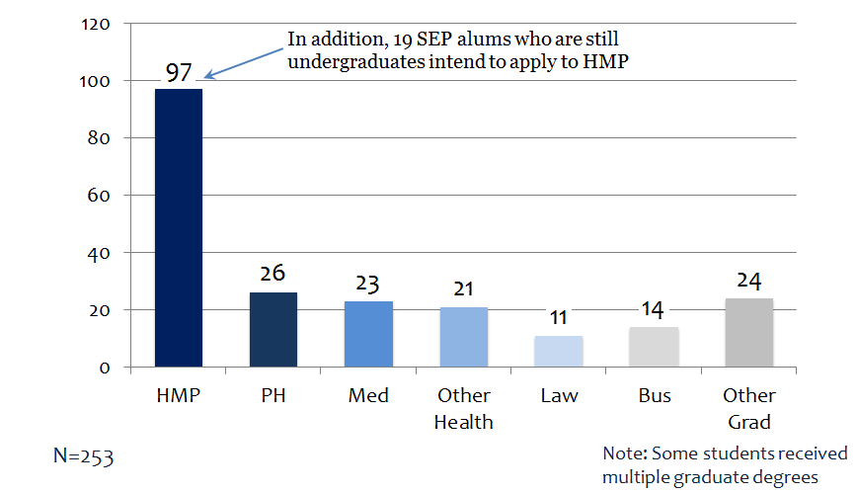
UM SEP Alumni Who Graduated from Graduate/Professional Programs

Slide 11
